Slide 1


ENSE-374 PROJECT
by
Team LaForge

Slide 2

Meet Our Team !!
Hasaan Toor
Lalith Souri
Rizwan Islam

Slide 3

Outline
Project Idea & Description
Roles & Responsibilities
Prototype
MVC Architecture Diagram
User Stories & Kanban
MVP
Feedback (Team Guinan & Tim)
Our Website (Demo Time!!)
Reflections
Questions?
The end

Slide 4

Project Idea & Description
Our idea is an interactive map of Canada that provides the user with tidbits of facts and general knowledge for each provinces and territory when clicking them.
This interactive map will be based on Model-View-Controller design architecture. Our reason for making such a project is to aim to help the average user gain information about Canada.
One potential use of our map is for travelers to decide where to go within Canada.

Slide 5
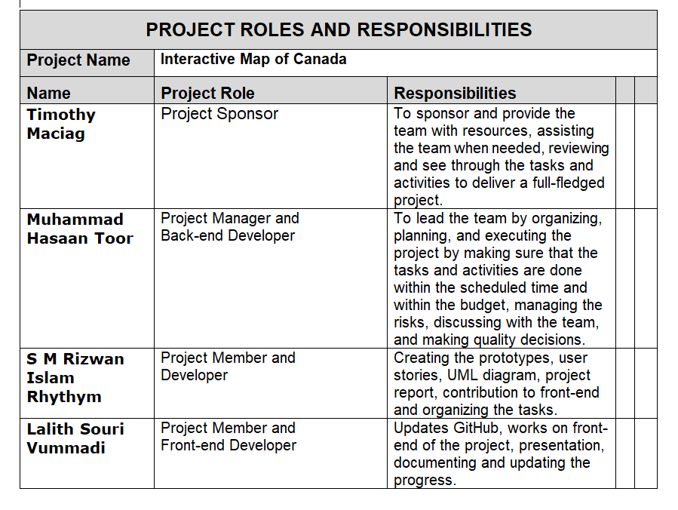
Roles & Responsibilities

Slide 6
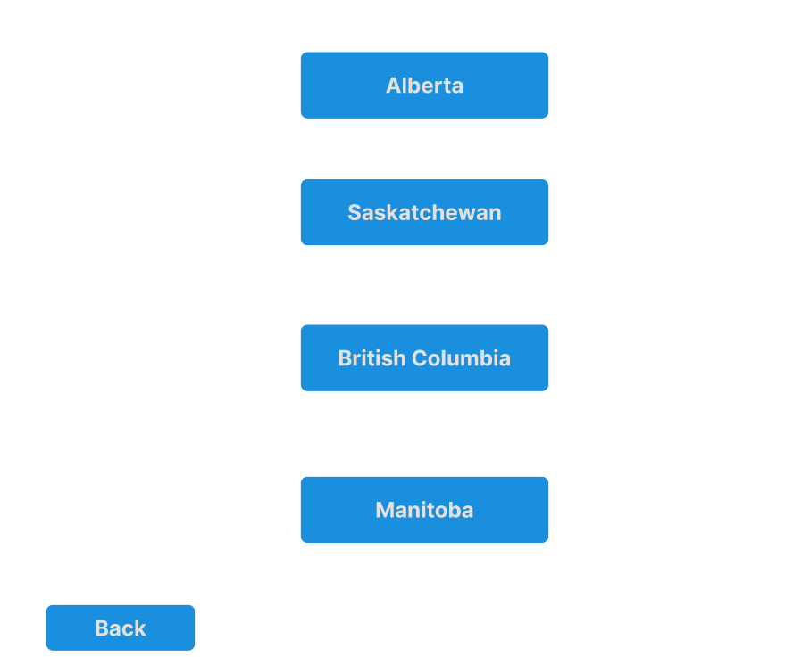
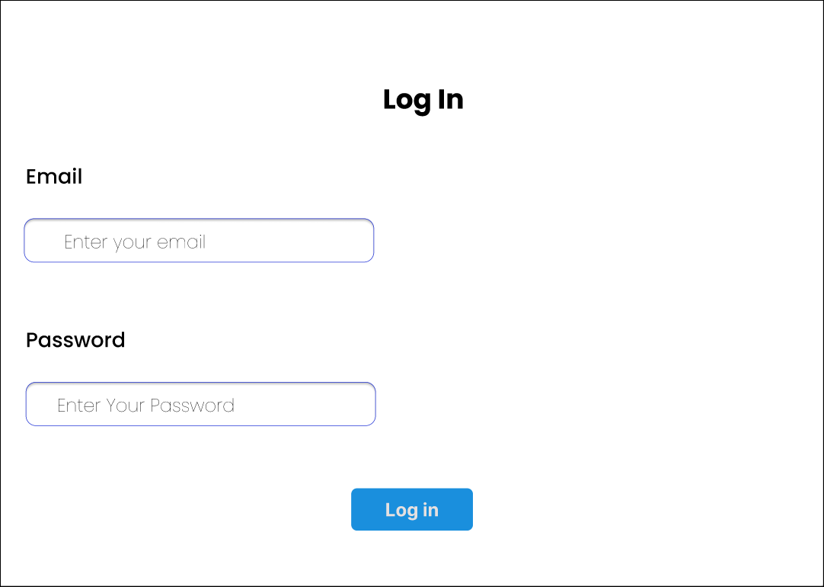
Prototype
Below are the login page and homepage of our project’s Hi-fi prototype.

Slide 7
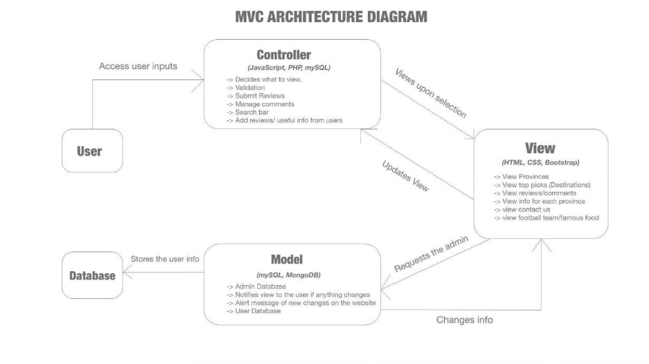
MVC Architecture Diagram

Slide 8
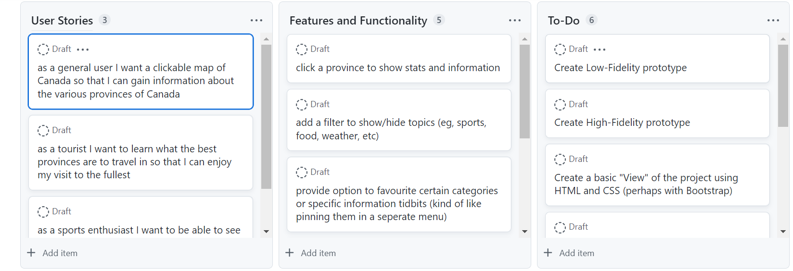
User Stories and Kanban

Slide 9
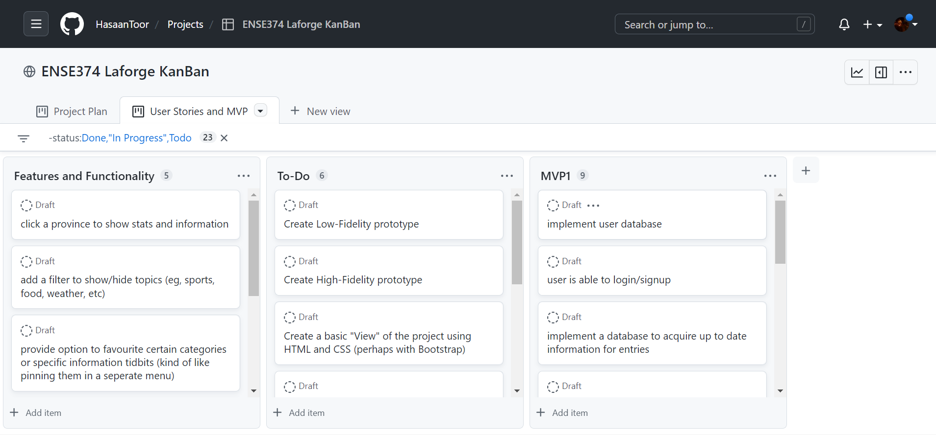
MVP

Slide 10
Feedback (Team Guinan and Tim)
Our original idea was a bit too ambitious for the scope of this class
Student feedback included adding additional features such as hovering over different cities / including educational institutions as well
Followed the advice given to us and decided to stick to just a few topics rather than a lot (tourism and sport) and enabled the community of users to be able to communicate with each other on said topics.

Slide 11
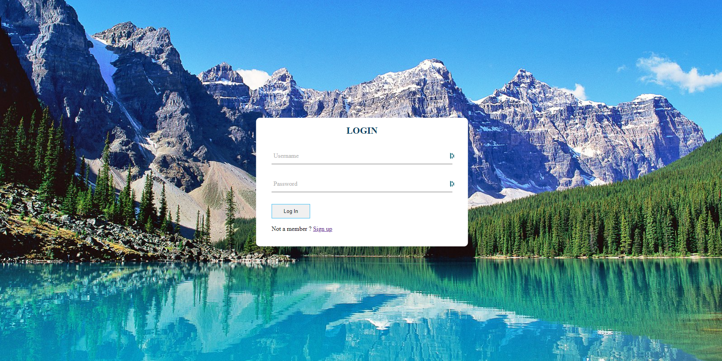
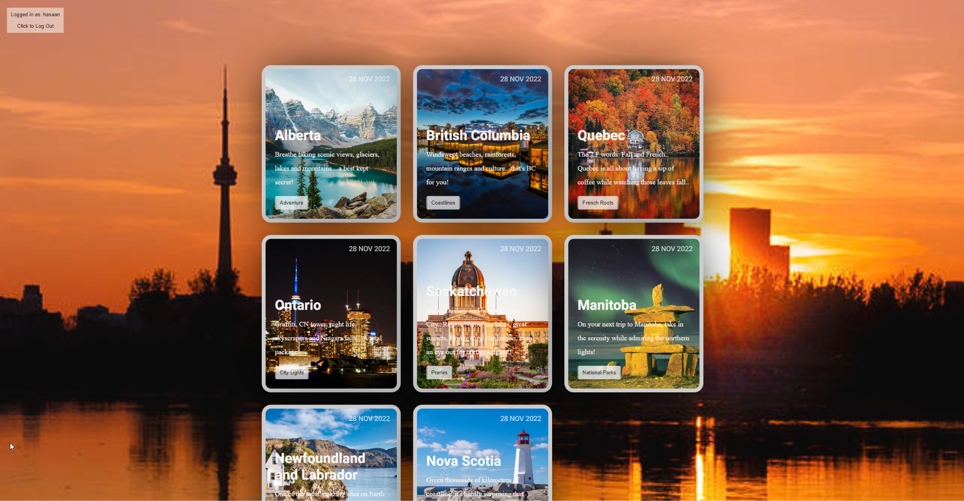
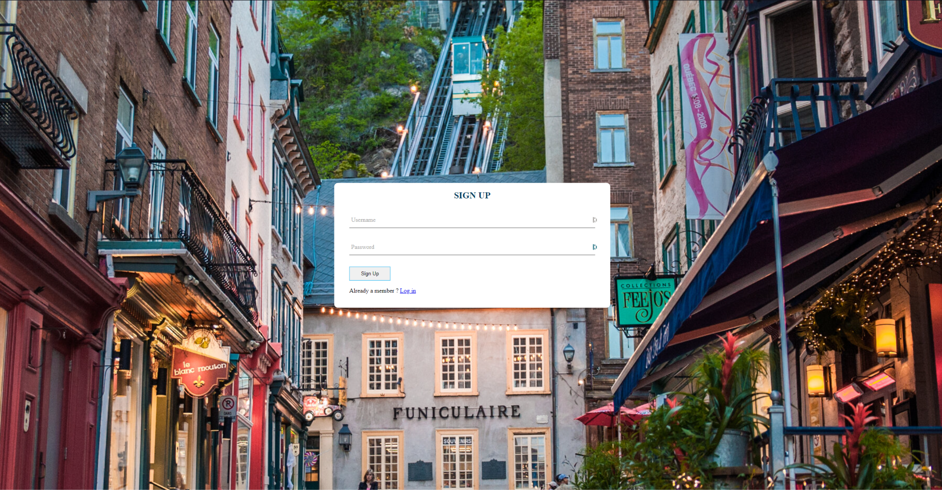
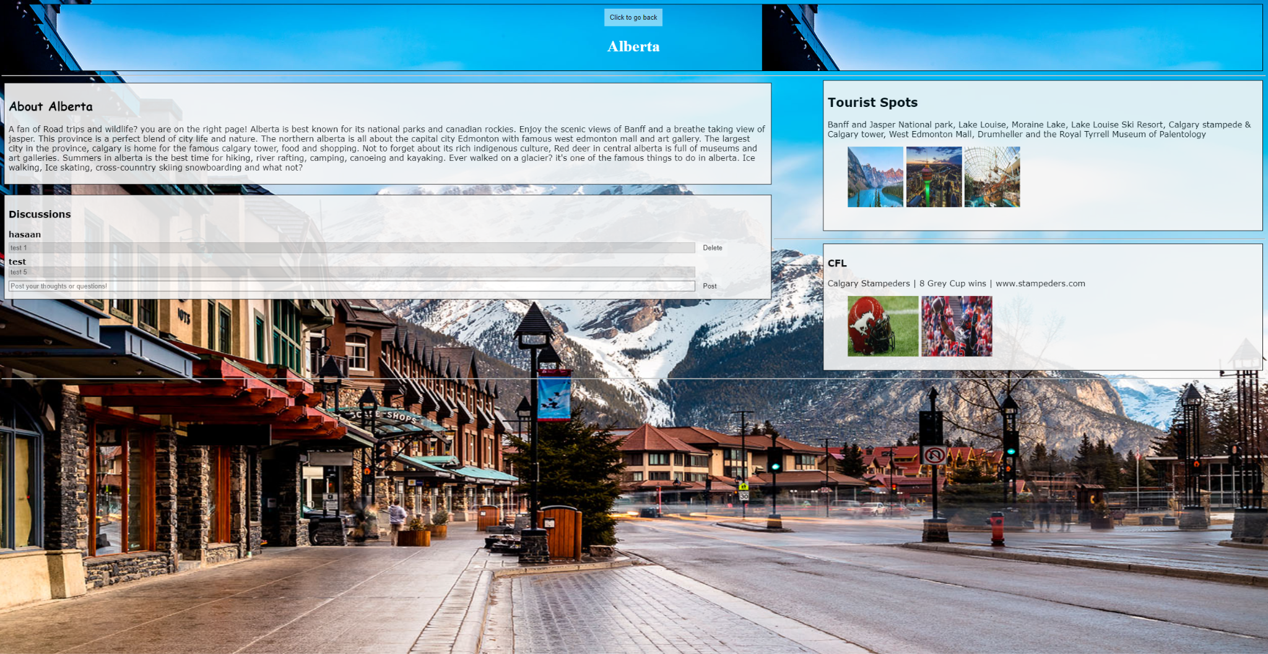
Our Website (Demo Time!!)

Slide 12


Reflections

Slide 13

Questions?

Slide 14
Thank you!!

